Slide 1
Planning through an Equity Lens

Slide 2
Shonnda R. Smith, Senior Director

Slide 3
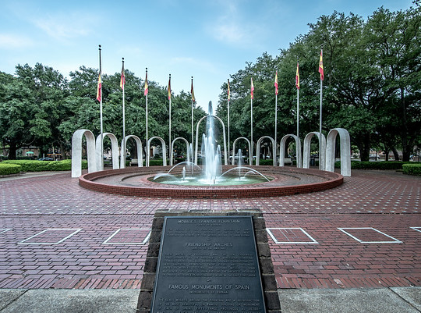
City of Mobile
A City before Alabama became a State
Pop: 192,085
Poverty Rate: 19%
Unemployment: 4%
Demographics: 50.2% black, 43.5% White, and 2.85 Hispanic/Latino
36617 – 34% poverty,11% unemployment

Slide 4
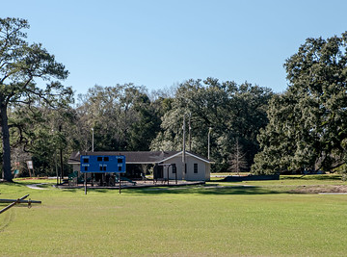
Opening Guidelines:
Recommendations are based on:
Alabama Health Dept. and CDC Guidelines
Hospital Bed Capacity
Level of person to person contact (tennis vs football) –
Number of people required for activity (individual vs team/group) –
Potential for groups/crowds (spectators) (Social Distancing)
Ability to sanitize and screen space
Does it make sense equitably

Slide 5
Health Protocol for Employees:
Train all employees on proper cleaning and disinfection, hand hygiene and respiratory etiquette.
Screen Employees Daily:
Have you been in close contact with a confirmed case of COVID-19
Are you experiencing a cough, shortness of breath or sore throat?
Have you had a fever in the last 48 hours?
Have you experienced new loss of taste or smell?
Have you experienced vomiting or diarrhea in the last 24 hours
Take Temp daily using temp-dot
Wash Hands or sanitize when entering the building and when transitioning to a new activity
Wear mask at all times.

Slide 6
Re-Opening through an Equity Lens
Current:
Providing Dinner and Breakfast Daily to youth at 12 sites
Delivering Senior meals weekly through our Senior Nutrition Program
Quality of Life Calls Daily for Seniors
Virtual programming posted daily- Seniors/Youth
Facilities on stand-by to become overload for hospitals or Homeless Shelters
Communicating resources
Re-Opening
Providing Summer Camp/Teen Camp – 12 sites
Considering using Senior Centers as Camp for further reach= 4 additional sites
Opening Saturdays
Not re-opening basketball courts or allowing high contact sports (Football, soccer, etc.)
Evening and weekend with modified activities and limited number of participants
Because of high contact and population not allowing Cards, Dominoes, or Basketball

Slide 7
Summer Camp – June 8 – July 31st 7:30-3:30pm
12 youth per room – 2 staff
Maintain group cohort
Staff must wear mask
Social distancing
Youth will be given individual kits with (crayons, pens, pencils and mask)
A lot of outside activities –weather permitting
Designated 2 sanitizing staff per site to clean down all rooms and amenities after every use.
No fieldtrips
Heavy emphasis on social distancing games
Priority given to neighborhood youth
Hold Zoom and Car Parent Summer Orientation
Hold Summer Camp Orientation for Counselors

Slide 8
Teen Camp – June 8 – July 31st 4:00-8:00pm
Same protocol as youth
Limited access
Must agree to screening, mask, and social distancing guidelines
Activities:
Life Skills
Career Readiness
Video Games
Art Classes
Basketball
Shoot around only no games
Dance classes
Tik-Tok

Slide 9
Other Opening:
Golf
Tennis Center
Gymnastics- with Camps and with modifications
Pools- Figures Only

Slide 10
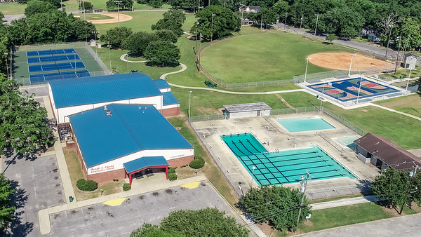
Questions?

